Slide 1

NLP Chatbot Development Using Dialogflow
Group Id: F24PROJECTB3B8C

Slide 2

Hafsa Javed
bc210414048

Slide 3
Introduction Of the Project
My project is an NLP-based Restaurent chatbot designed to automate customer interactions using Natural Language Processing (NLP). It enables users to make reservations, explore menus, place orders, and get support through an intelligent conversational interface. Built with Dialogflow, Python (Flask), and MySQL, this chatbot enhances user experience by providing quick and accurate responses on a web-based platform.

Slide 4

Purpose:
The Restaurant Chatbot automates customer interactions by handling reservations, menu navigation, order placement, and support, ensuring quick service and better user experience

Slide 5
Features:
Make Reservations – Book, modify, or cancel tables.
Menu Navigation – Explore menu items and categories.
Place Order – Order food and modify selections.
Customer Support – Live chat, FAQs, order tracking, and feedback.

Slide 6
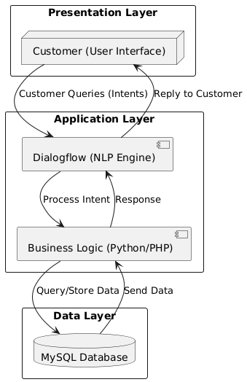
Technologies Used
Natural Language Processing (NLP): Dialogflow (for chatbot intelligence)
Backend: Python (Flask for API and database management)
Database: MySQL (for storing orders, reservations, and user data)
Frontend: HTML, CSS, JavaScript (for the web-based interface)
Integration: Webhooks (to connect chatbot with backend and database)

Slide 7
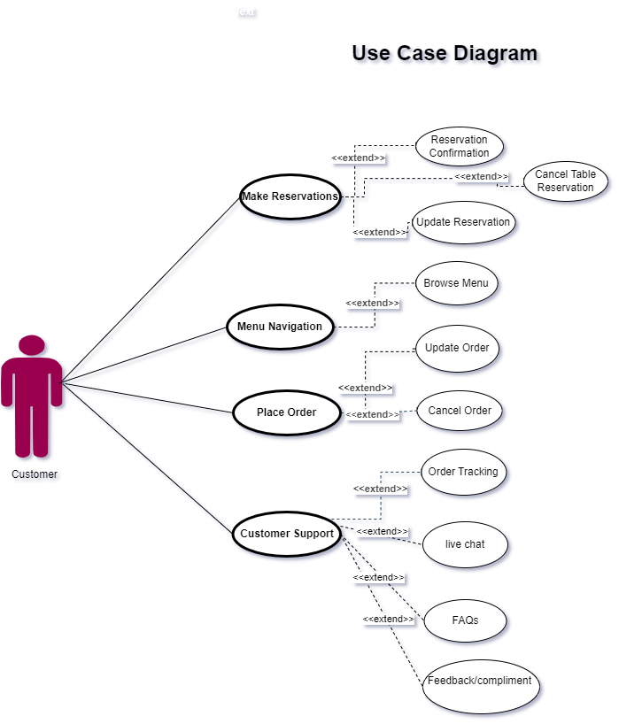
Use Case of Restaurant Chatbot
Show the audience you anticipated their questions.
Leave room for Q&A, but use the Appendix as a way to show that you both thought about those questions and have solid answers with supporting information. Let the audience test their understanding of the problem and the solution you’ve outlined - questions give them a chance to talk themselves into your approach, and give you a chance to show mastery of the subject.

Slide 8
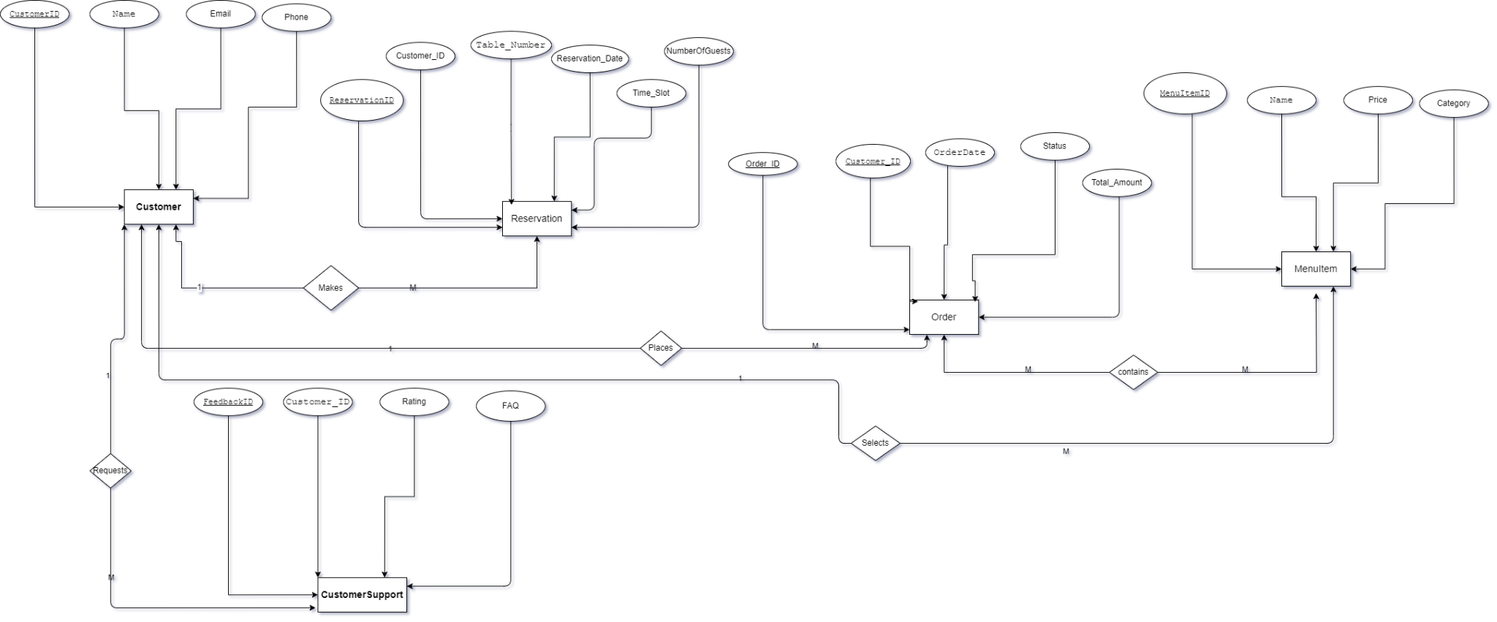
ERD
Show the audience you anticipated their questions.
Leave room for Q&A, but use the Appendix as a way to show that you both thought about those questions and have solid answers with supporting information. Let the audience test their understanding of the problem and the solution you’ve outlined - questions give them a chance to talk themselves into your approach, and give you a chance to show mastery of the subject.

Slide 9
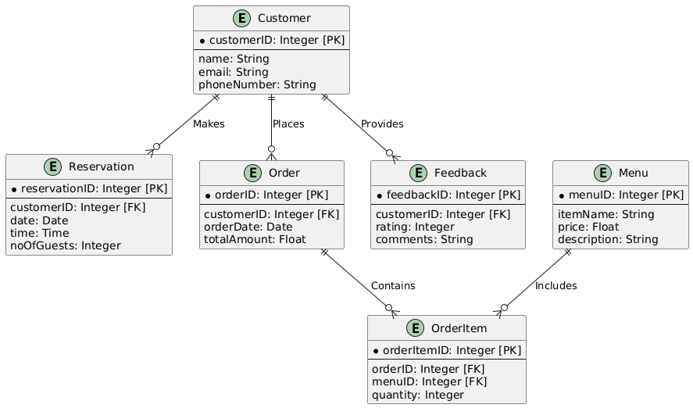
Database Diagram
Show the audience you anticipated their questions.
Leave room for Q&A, but use the Appendix as a way to show that you both thought about those questions and have solid answers with supporting information. Let the audience test their understanding of the problem and the solution you’ve outlined - questions give them a chance to talk themselves into your approach, and give you a chance to show mastery of the subject.

Slide 10
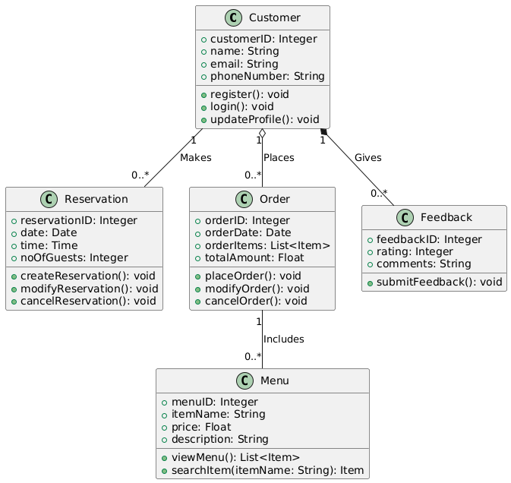
Class Diagram
Show the audience you anticipated their questions.
Leave room for Q&A, but use the Appendix as a way to show that you both thought about those questions and have solid answers with supporting information. Let the audience test their understanding of the problem and the solution you’ve outlined - questions give them a chance to talk themselves into your approach, and give you a chance to show mastery of the subject.

Slide 11
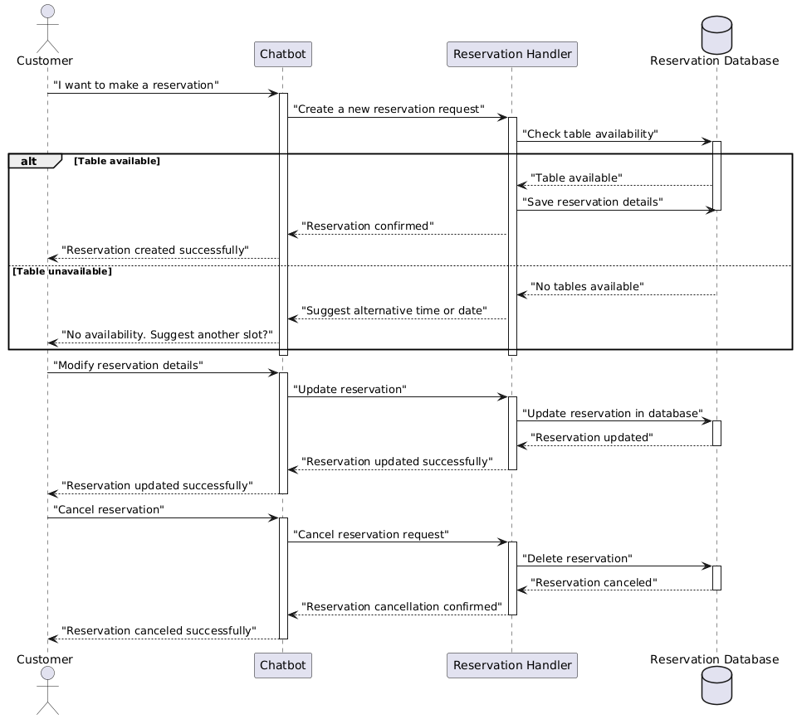
Reservation Sequence Diagram
Show the audience you anticipated their questions.
Leave room for Q&A, but use the Appendix as a way to show that you both thought about those questions and have solid answers with supporting information. Let the audience test their understanding of the problem and the solution you’ve outlined - questions give them a chance to talk themselves into your approach, and give you a chance to show mastery of the subject.

Slide 12
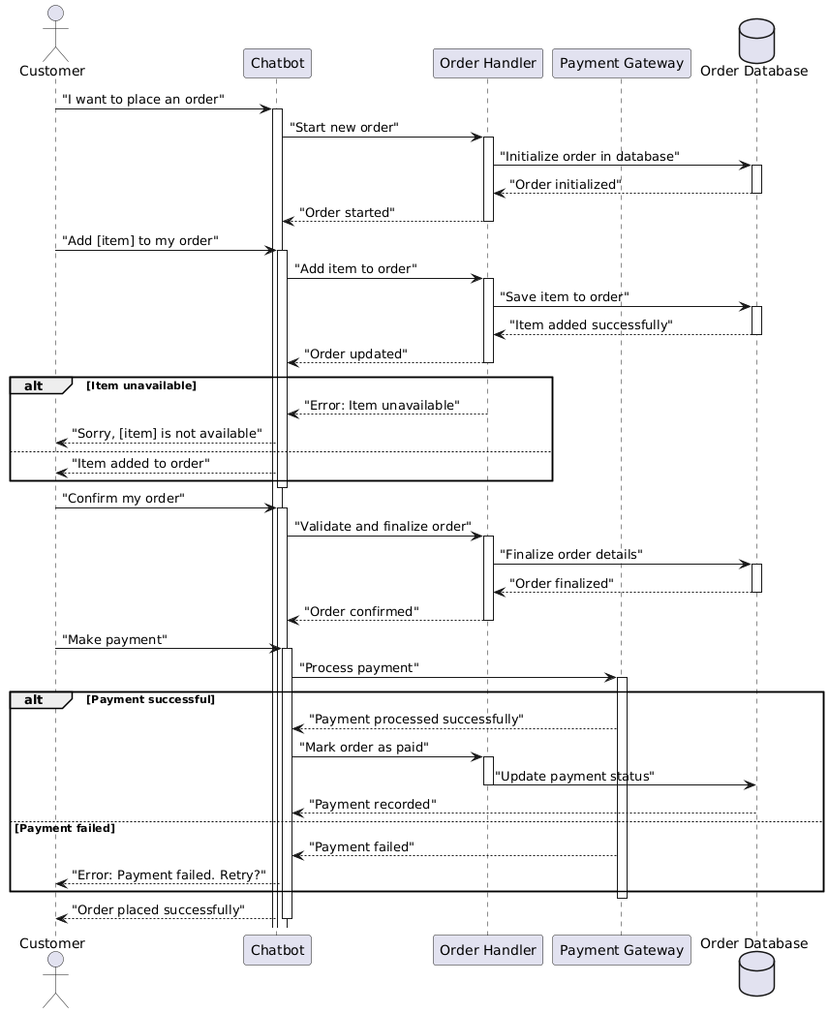
Order Sequence Diagram

Slide 13
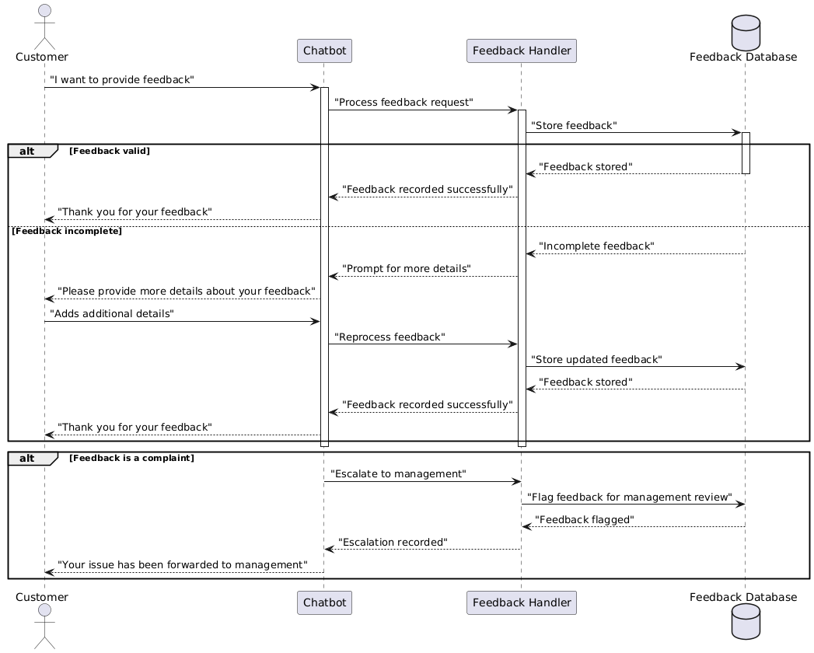
Feedback Sequence Diagram
Show the audience you anticipated their questions.
Leave room for Q&A, but use the Appendix as a way to show that you both thought about those questions and have solid answers with supporting information. Let the audience test their understanding of the problem and the solution you’ve outlined - questions give them a chance to talk themselves into your approach, and give you a chance to show mastery of the subject.

Slide 14
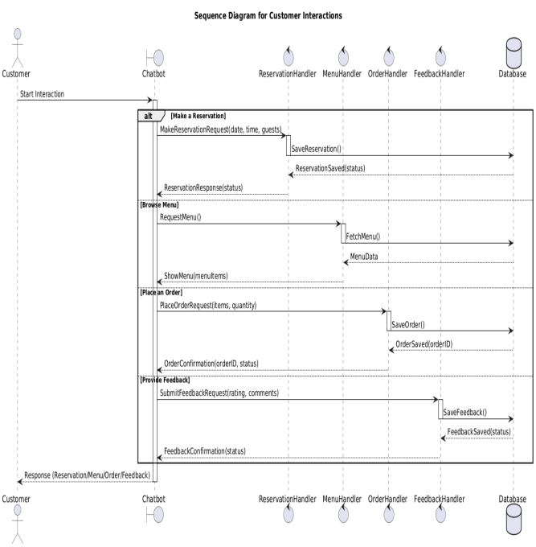
Customer Sequence Diagram
Show the audience you anticipated their questions.
Leave room for Q&A, but use the Appendix as a way to show that you both thought about those questions and have solid answers with supporting information. Let the audience test their understanding of the problem and the solution you’ve outlined - questions give them a chance to talk themselves into your approach, and give you a chance to show mastery of the subject.

Slide 15
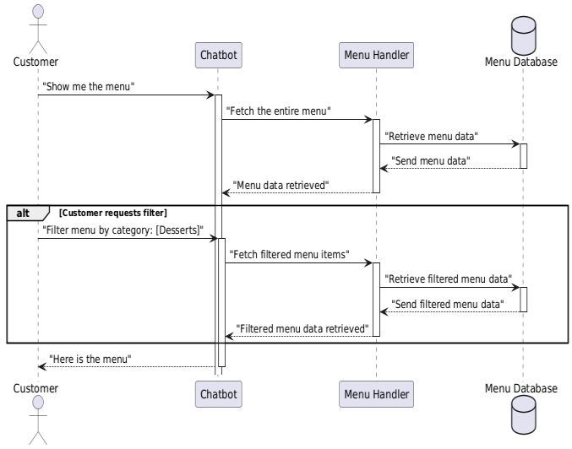
Menu Sequence Diagram
Show the audience you anticipated their questions.
Leave room for Q&A, but use the Appendix as a way to show that you both thought about those questions and have solid answers with supporting information. Let the audience test their understanding of the problem and the solution you’ve outlined - questions give them a chance to talk themselves into your approach, and give you a chance to show mastery of the subject.

Slide 16
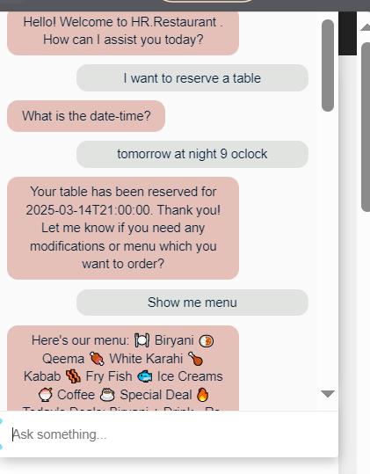
Restaurant Chatbot
Show the audience you anticipated their questions.
Leave room for Q&A, but use the Appendix as a way to show that you both thought about those questions and have solid answers with supporting information. Let the audience test their understanding of the problem and the solution you’ve outlined - questions give them a chance to talk themselves into your approach, and give you a chance to show mastery of the subject.

Slide 17
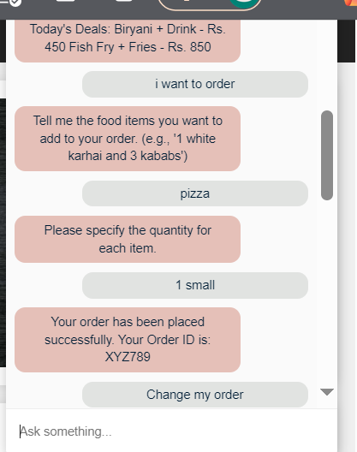
Restaurant Chatbot
Show the audience you anticipated their questions.
Leave room for Q&A, but use the Appendix as a way to show that you both thought about those questions and have solid answers with supporting information. Let the audience test their understanding of the problem and the solution you’ve outlined - questions give them a chance to talk themselves into your approach, and give you a chance to show mastery of the subject.

Slide 18
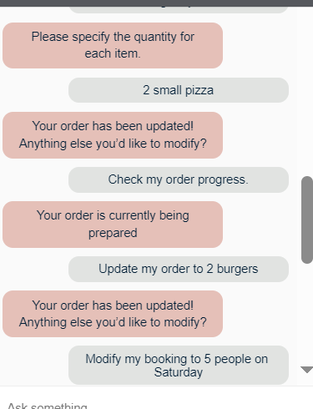
Restaurant Chatbot
Show the audience you anticipated their questions.
Leave room for Q&A, but use the Appendix as a way to show that you both thought about those questions and have solid answers with supporting information. Let the audience test their understanding of the problem and the solution you’ve outlined - questions give them a chance to talk themselves into your approach, and give you a chance to show mastery of the subject.

Slide 19
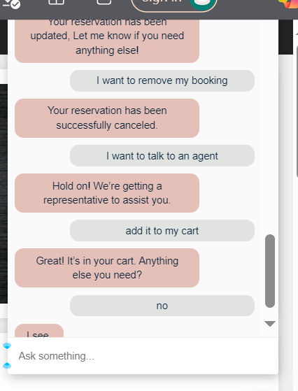
Restaurant Chatbot
Show the audience you anticipated their questions.
Leave room for Q&A, but use the Appendix as a way to show that you both thought about those questions and have solid answers with supporting information. Let the audience test their understanding of the problem and the solution you’ve outlined - questions give them a chance to talk themselves into your approach, and give you a chance to show mastery of the subject.

Slide 20
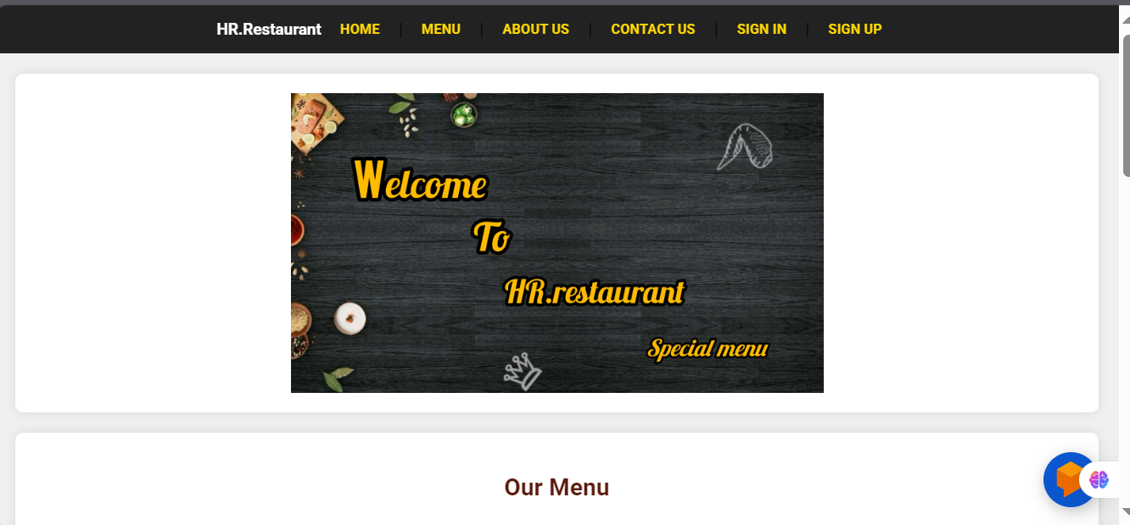
User Interfaces
Show the audience you anticipated their questions.
Leave room for Q&A, but use the Appendix as a way to show that you both thought about those questions and have solid answers with supporting information. Let the audience test their understanding of the problem and the solution you’ve outlined - questions give them a chance to talk themselves into your approach, and give you a chance to show mastery of the subject.

Slide 21
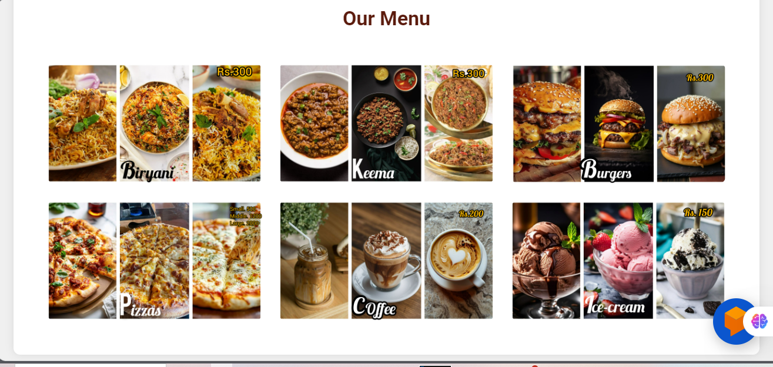
User Interfaces
Show the audience you anticipated their questions.
Leave room for Q&A, but use the Appendix as a way to show that you both thought about those questions and have solid answers with supporting information. Let the audience test their understanding of the problem and the solution you’ve outlined - questions give them a chance to talk themselves into your approach, and give you a chance to show mastery of the subject.

Slide 22
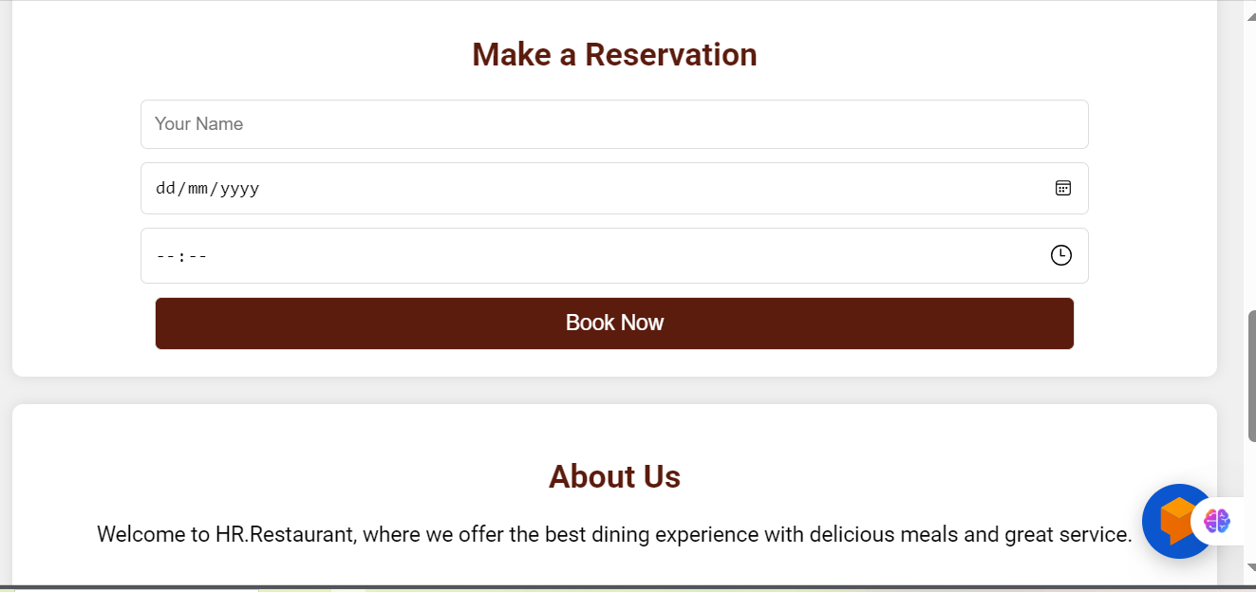
User Interfaces
Show the audience you anticipated their questions.
Leave room for Q&A, but use the Appendix as a way to show that you both thought about those questions and have solid answers with supporting information. Let the audience test their understanding of the problem and the solution you’ve outlined - questions give them a chance to talk themselves into your approach, and give you a chance to show mastery of the subject.

Slide 23
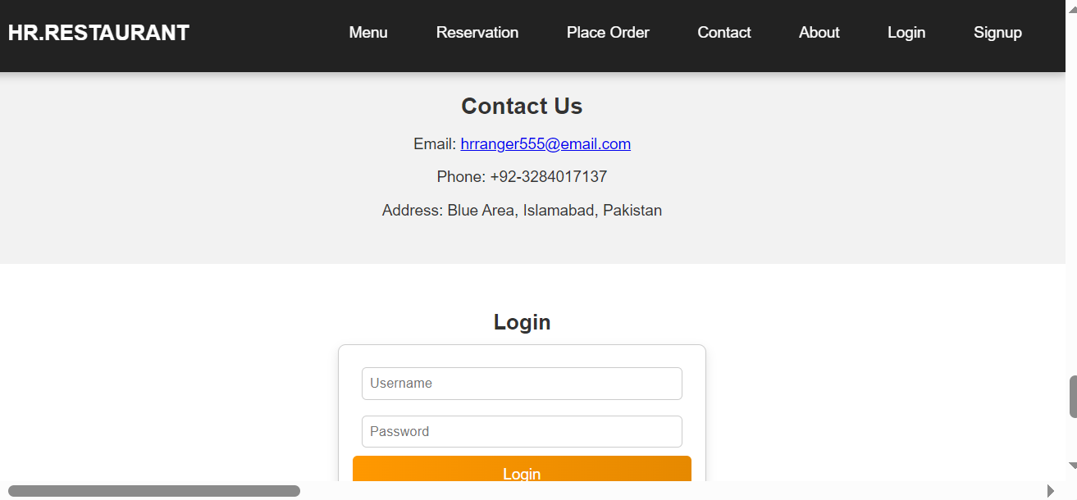
User Interfaces
Show the audience you anticipated their questions.
Leave room for Q&A, but use the Appendix as a way to show that you both thought about those questions and have solid answers with supporting information. Let the audience test their understanding of the problem and the solution you’ve outlined - questions give them a chance to talk themselves into your approach, and give you a chance to show mastery of the subject.

Slide 24
githublink
Show the audience you anticipated their questions.
Leave room for Q&A, but use the Appendix as a way to show that you both thought about those questions and have solid answers with supporting information. Let the audience test their understanding of the problem and the solution you’ve outlined - questions give them a chance to talk themselves into your approach, and give you a chance to show mastery of the subject.
https://github.com/hrranger5/HR.Restaurantweb.git

